Slide 1

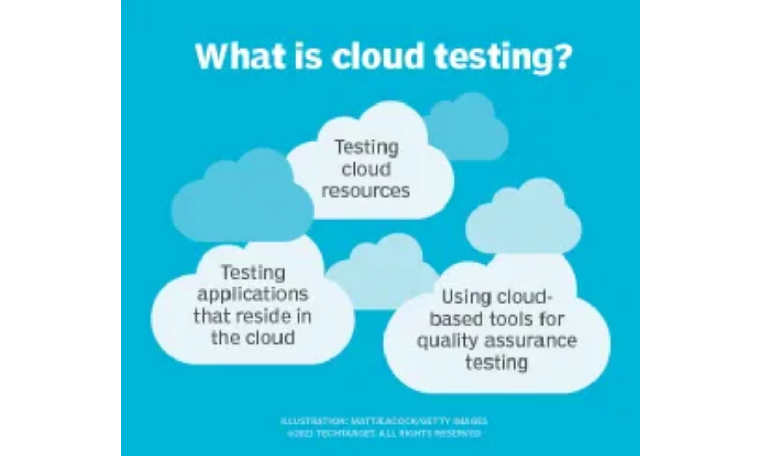
Executive Summary
Cloud Testing Market Research
Focus Areas
Frontend (Angular) testing approaches
Backend (JavaScript, C#/.NET) testing strategies
API-centered interactions and testing
Cloud-native and distributed systems testing
Key Findings
Multi-layered testing approach is essential for cloud systems
Shift-left testing reduces costs and improves quality
Research Outcomes
Ephemeral environments provide consistency and isolation
Comprehensive test type analysis
CI/CD integration is critical for continuous quality
Strategic testing patterns comparison
Tool selection should be based on specific ecosystem needs
Environment strategy recommendations
CI/CD integration best practices
Tool comparison matrix across categories
Generic test strategy framework
Functional proof of concept implementation
Cloud Testing Market Research
1

Slide 2

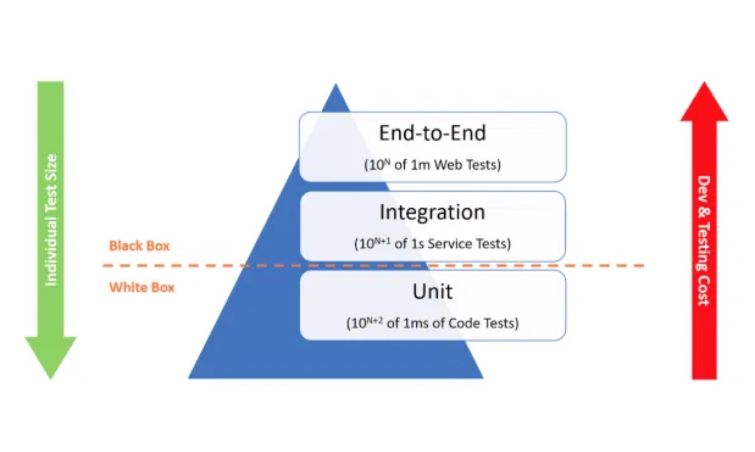
Key Test Types for Cloud Systems
Essential Test Types
Unit Testing
Testing individual components in isolation; essential for early bug detection
Component Testing
Testing modules with immediate dependencies; crucial for microservices
Integration Testing
Verifying interactions between services; addresses interface issues
End-to-End (E2E) Testing
Simulating complete user flows; validates entire system functionality
Cloud Testing Considerations
API Testing
Testing interfaces directly; paramount for microservices communication
Distributed Nature:
Tests must account for network latency and failures
Performance Testing
Scalability:
Tests should verify behavior under varying loads
Evaluating system under various loads; optimizes resource consumption
Statelessness:
Services should be tested for proper state management
Security Testing
Data Consistency:
Tests must verify data integrity across services
Identifying vulnerabilities; critical for shared responsibility model
Resilience:
Tests should verify system recovery from failures
Cost Optimization:
Tests should be designed for efficiency
Accessibility Testing
Ensuring usability for all users; important for public-facing applications
Cloud Testing Market Research
2

Slide 3

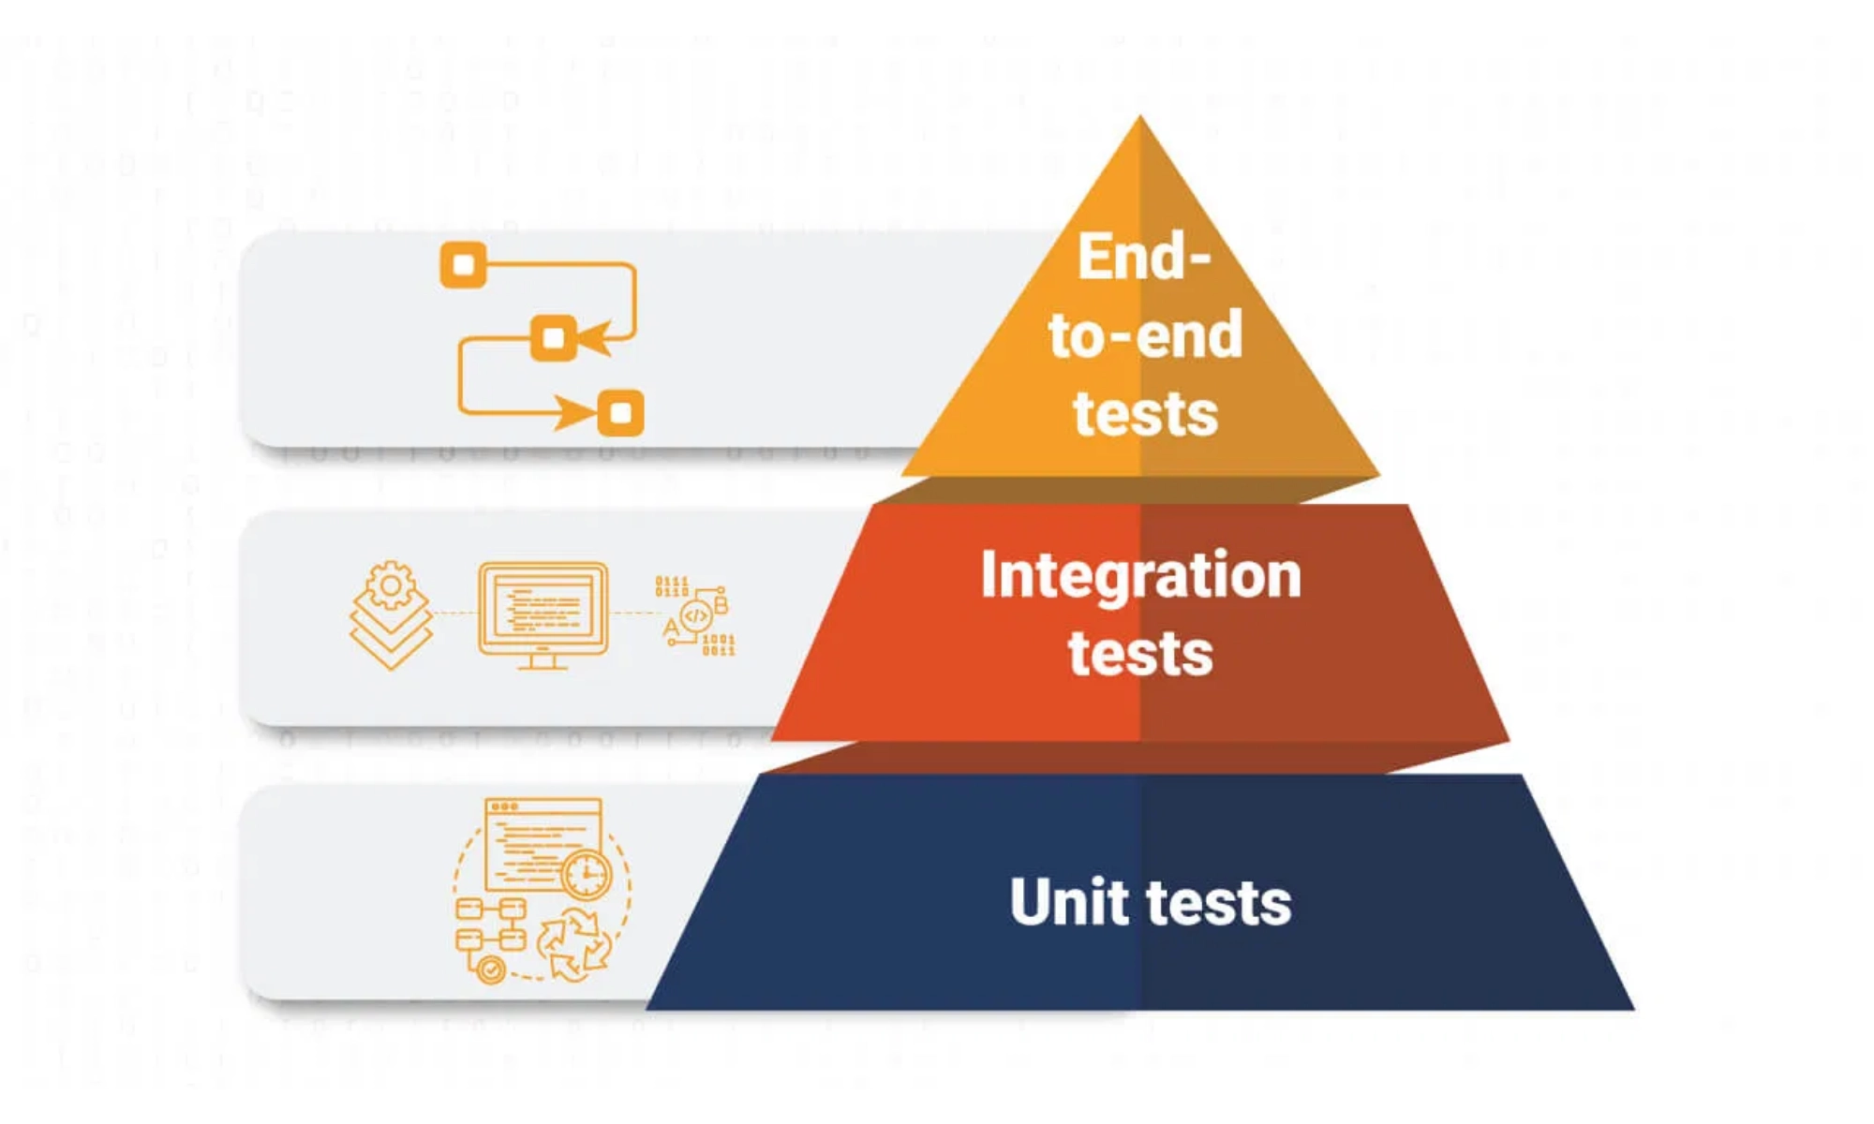





Test Strategy Patterns
Strategic Testing Approaches
Test Pyramid
Hierarchical approach with many unit tests (base), fewer integration tests (middle), and minimal E2E tests (top). Optimizes for speed and cost-efficiency.
Testing Trophy
Modern approach emphasizing static analysis (base), unit tests, integration tests (largest portion), and fewer E2E tests. Prioritizes ROI and developer experience.
Strategy Selection Factors
Shift-Left Testing
Moving testing earlier in development lifecycle. Detects defects earlier, improves collaboration, and reduces rework costs.
Application Architecture:
Microservices benefit from contract testing
Team Structure:
Distributed teams need clear testing boundaries
Release Frequency:
Frequent releases need automation focus
Service Virtualization
Risk Profile:
Critical systems need comprehensive testing
Simulating dependent components for testing. Reduces dependencies, enables parallel development, and speeds up test execution.
Resource Constraints:
Limited resources need strategic test selection
Contract Testing
Verifying API contracts between services. Prevents integration issues, allows independent deployment, and provides fast feedback.
Cloud Testing Market Research
3

Slide 4

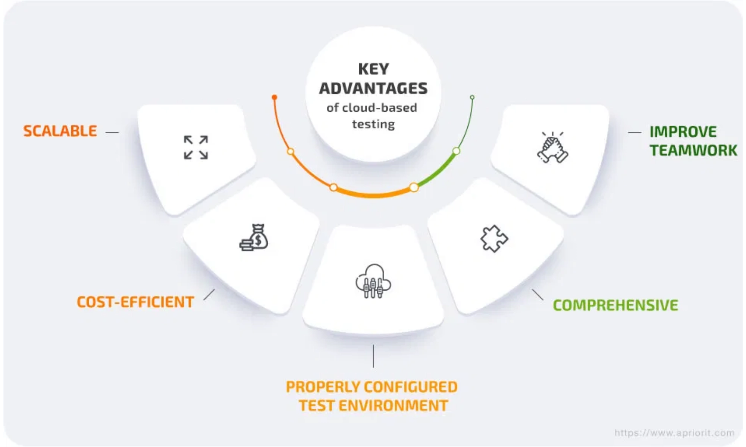




Environment Strategies
Cloud Testing Environments
Ephemeral Test Environments
Short-lived, isolated, and disposable deployments created for specific purposes and automatically destroyed afterward. Essential for modern CI/CD pipelines.
Isolation
Reproducibility
Cost-effective
Mocks and Stubs
Test doubles that simulate the behavior of dependencies during testing. Stubs provide canned answers, while mocks verify interactions and expectations.
Implementation Best Practices
Speed
Control
Isolation
Containerization:
Use Docker and Kubernetes for consistent, isolated
environments
Data Seeding and Anonymization
Infrastructure as Code:
Define environments using Terraform or
Populating test environments with relevant data (seeding) and protecting sensitive information (anonymization) to ensure consistent, compliant testing.
CloudFormation
Database Management:
Implement automated reset mechanisms and
seeding scripts
Reproducibility
Compliance
Realism
Data Protection:
Apply masking, tokenization, or synthetic data
generation
Automation:
Automate environment creation, testing, and teardown
Cloud Testing Market Research
4

Slide 5

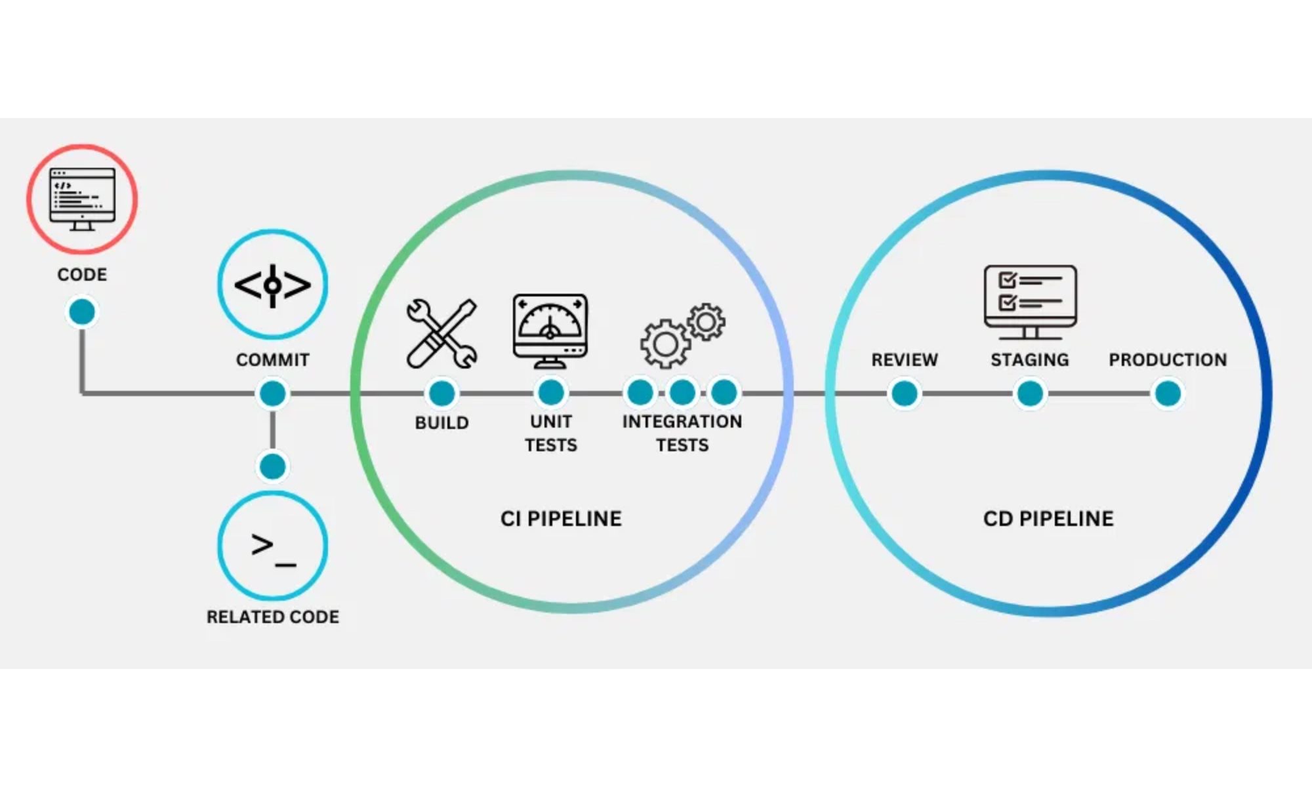







CI/CD Integration Practices
Azure DevOps Testing Integration
Fast Feedback in Pull Requests
PR pipelines provide immediate feedback to developers, catching issues early:
Code building and dependency checks
Static code analysis and linting
Unit tests execution
PR review requirements
Quality Gates
Critical checkpoints enforcing quality criteria:
Azure DevOps Best Practices
Pre-merge checks (PR pipeline)
Post-merge checks (CI pipeline)
Branch Policies:
Enforce code quality standards and reviews
Deployment gates (CD pipeline)
Pipeline Templates:
Standardize testing across projects
Production readiness verification
Test Analytics:
Track test health and trends over time
Pipeline Optimization
Security Scanning:
Integrate security testing in pipelines
Caching:
Dependency and build caching to speed up pipelines
Environment Management:
Automate test environment provisioning
Parallelization:
Running tests in parallel to reduce execution time
Test Selection:
Running only affected tests based on code changes
Cloud Testing Market Research
5

Slide 6
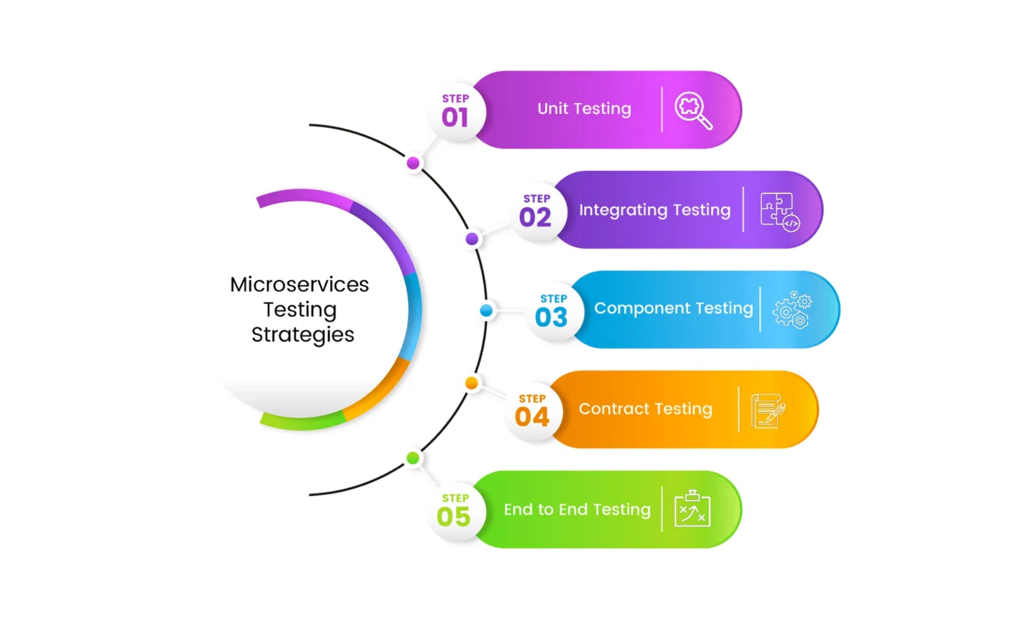






Interoperability Specifics
Key Interoperability Considerations
API Versioning
Proper versioning strategies (URI path, query parameter, header) ensure backward compatibility while allowing evolution of services.
Idempotency
Operations must be designed and tested to be safely repeatable, especially for distributed transactions that may be retried.
Retries and Timeouts
Services must implement and test appropriate retry policies with exponential backoff and jitter to handle transient failures.
Rate Limiting and Throttling
Additional Considerations
Tests must verify proper handling of rate limits, including appropriate response codes and retry-after headers.
Network Variability and Latency
Tests must simulate network conditions including latency, packet loss, and jitter to ensure resilience.
Data Consistency
Tests must verify eventual consistency patterns and proper handling of distributed transactions.
Cloud Testing Market Research
6

Slide 7

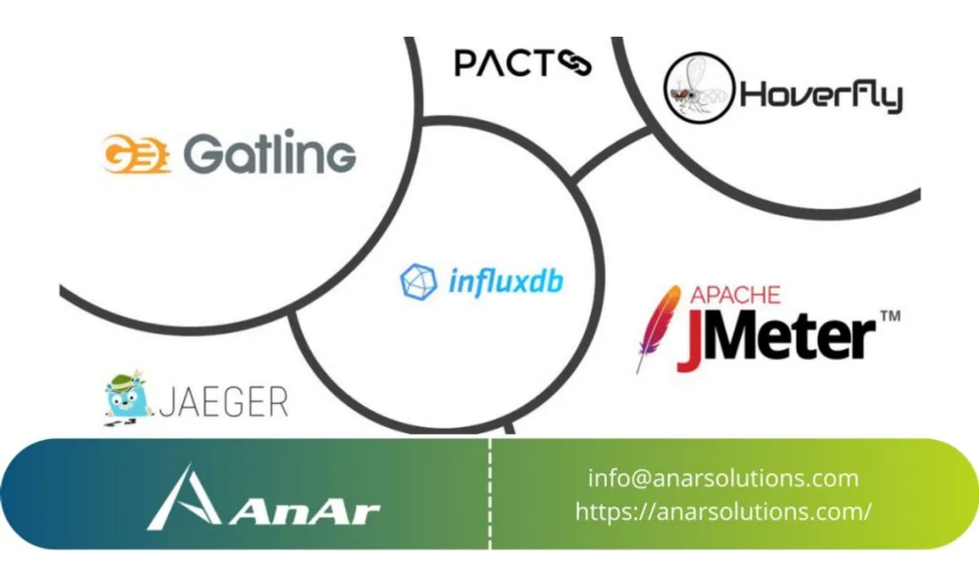





Tool Comparison Matrix
Testing Tools Comparison
Unit Testing
Jest
All-in-one
Slower on large projects
xUnit.net
Modern, extensible
Steeper learning curve
NUnit
Feature-rich
More verbose
Integration & API Testing
Postman
User-friendly
Resource-intensive
RestSharp
Simple syntax
No GUI
Supertest
Fluent API
JS ecosystem only
Performance Testing
End-to-End (E2E) Testing
JMeter
Highly extensible
Dated UI
Cypress
Excellent debugging
Limited cross-browser
k6
Developer-centric
API-focused
Playwright
Multi-language
Newer community
Azure Load Testing
Managed service
Vendor lock-in
Selenium
Widest support
Complex setup
Security & Accessibility Testing
OWASP ZAP
Open-source
Learning curve
Axe
Easy integration
Automated only
SonarQube
Comprehensive
Complex setup
Selection Criteria
Functional depth and feature completeness
Developer experience and learning curve
CI/CD integration capabilities
Performance and reliability
Licensing model and cost structure
Community support and ecosystem
Cloud Testing Market Research
7

Slide 8

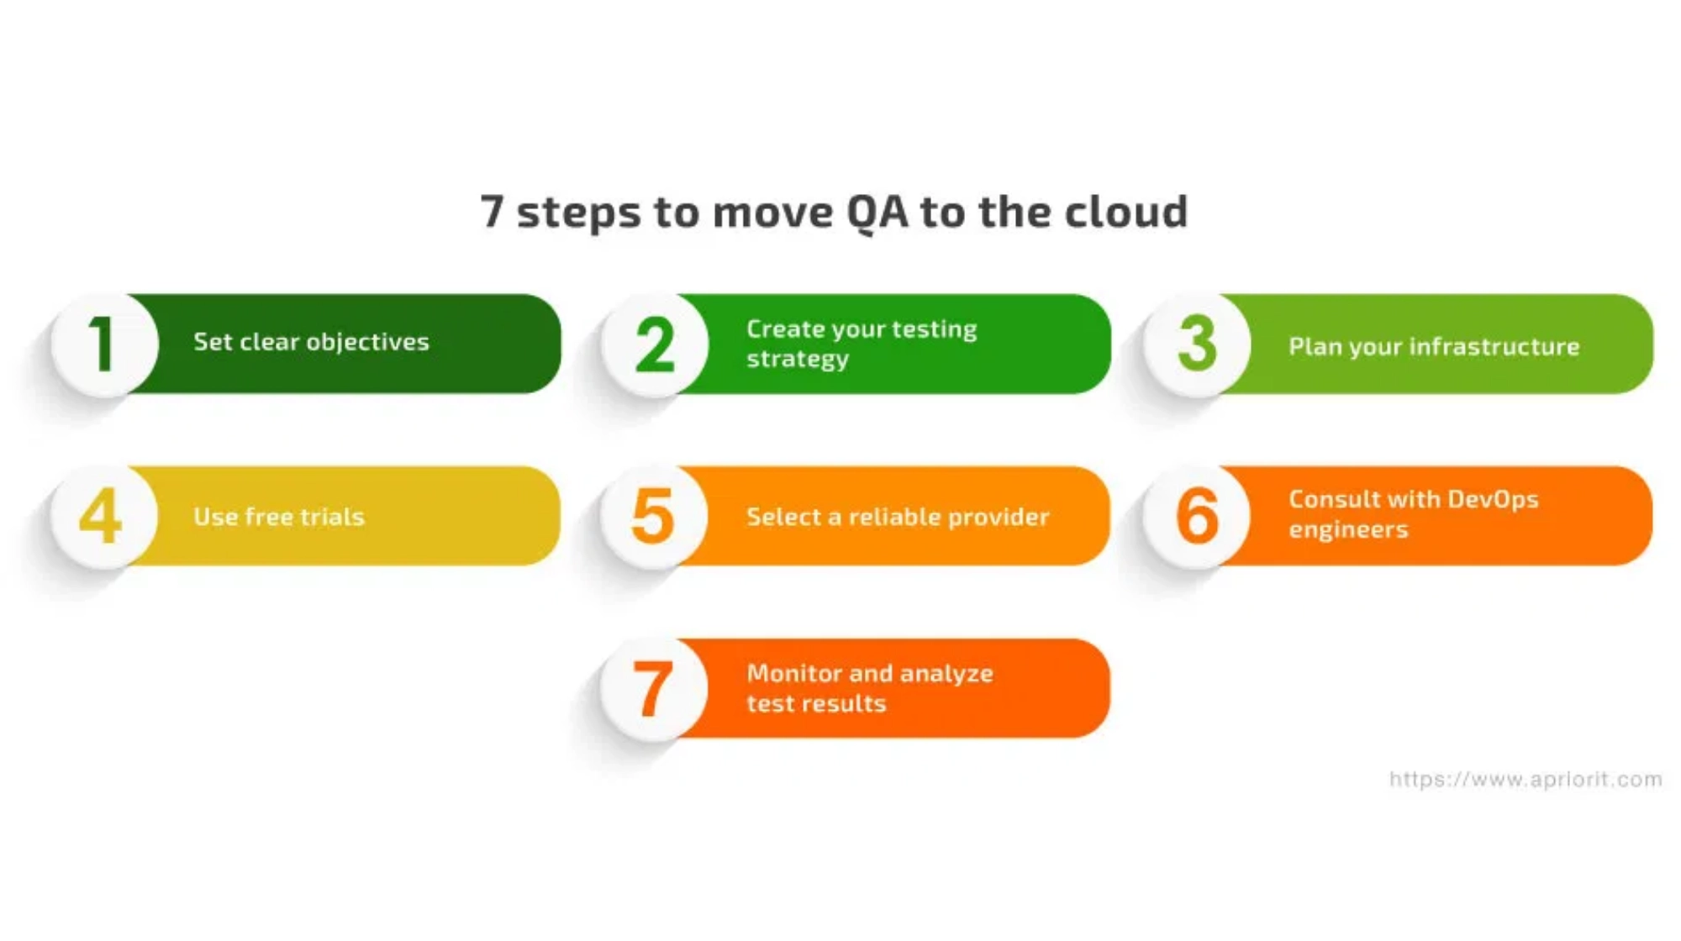





Generic Test Strategy for Cloud Applications
Cloud Testing Strategy Framework
Strategy Principles
Shift-Left:
Integrate testing early in development
Automate Everything:
Maximize automation for speed
Layered Testing:
Follow test pyramid principles
Environment Parity:
Mirror production closely
Test Phases
Continuous Feedback:
Provide rapid insights
Phase 1: Development & Local Testing
Observability:
Monitor application behavior
Unit tests, component tests, static analysis
Supporting Strategies
Phase 2: Continuous Integration
Data Management:
Automated seeding, anonymization, database reset
Integration tests, API tests, contract tests, security scans
Flakiness Management:
Test isolation, retries, explicit waits
Continuous Improvement:
Regular reviews, feedback loops, metrics
Phase 3: Test Environment Validation
E2E tests, performance tests, security tests, accessibility tests
Phase 4: Pre-Production & Release
Smoke tests, chaos engineering, observability checks
Cloud Testing Market Research
8

Slide 9

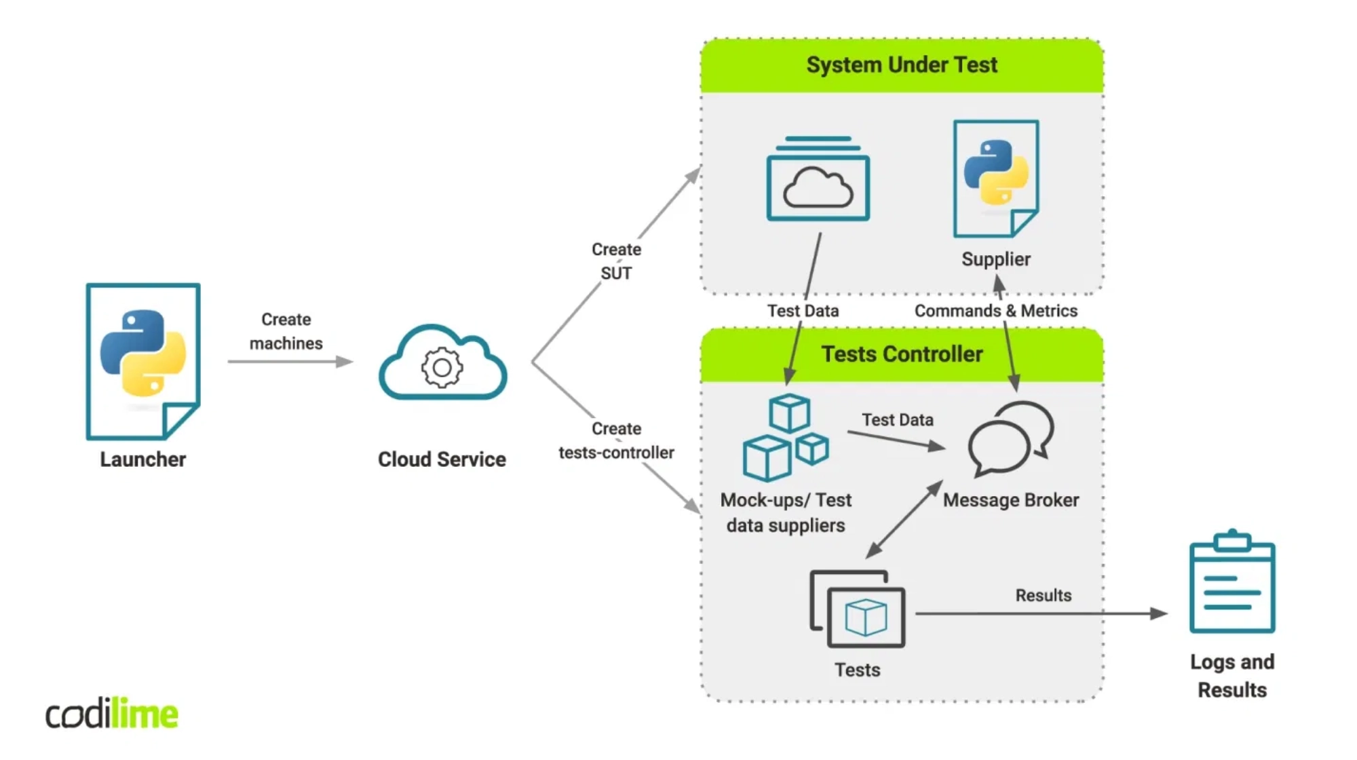








Proof of Concept Implementation
Cloud Testing PoC
Architecture Overview
Microservices Architecture:
Flask backend API with React frontend
Data Layer:
SQLite for development, containerized for production
Containerization:
Docker with separate services for backend, frontend,
and tests
Test Types Implemented
Unit Tests
Integration Tests
Test Execution Results
Backend models and functions
API endpoints and database
Unit Tests:
4/4 passed (0.27s execution)
Contract Tests
Frontend Tests
Integration Tests:
6/6 passed (0.35s execution)
API contract verification
React component testing
Frontend Tests:
8/10 passed (demonstrating test failures)
E2E Tests
Performance Tests
Docker Orchestration:
Successfully containerized all components
Full user journey testing
API response time testing
Practical Applications
Testing Patterns Demonstrated
CI/CD Integration:
Ready for GitHub Actions or Azure DevOps
Test Pyramid implementation
Shift-left testing with CI integration
Cloud Deployment:
Containerized for any cloud provider
Service virtualization with mocks
Scalability:
Pattern can be extended for larger applications
Contract testing between frontend/backend
Documentation:
Comprehensive README with setup instructions
Ephemeral test environments with Docker
Cloud Testing Market Research
9

Slide 10

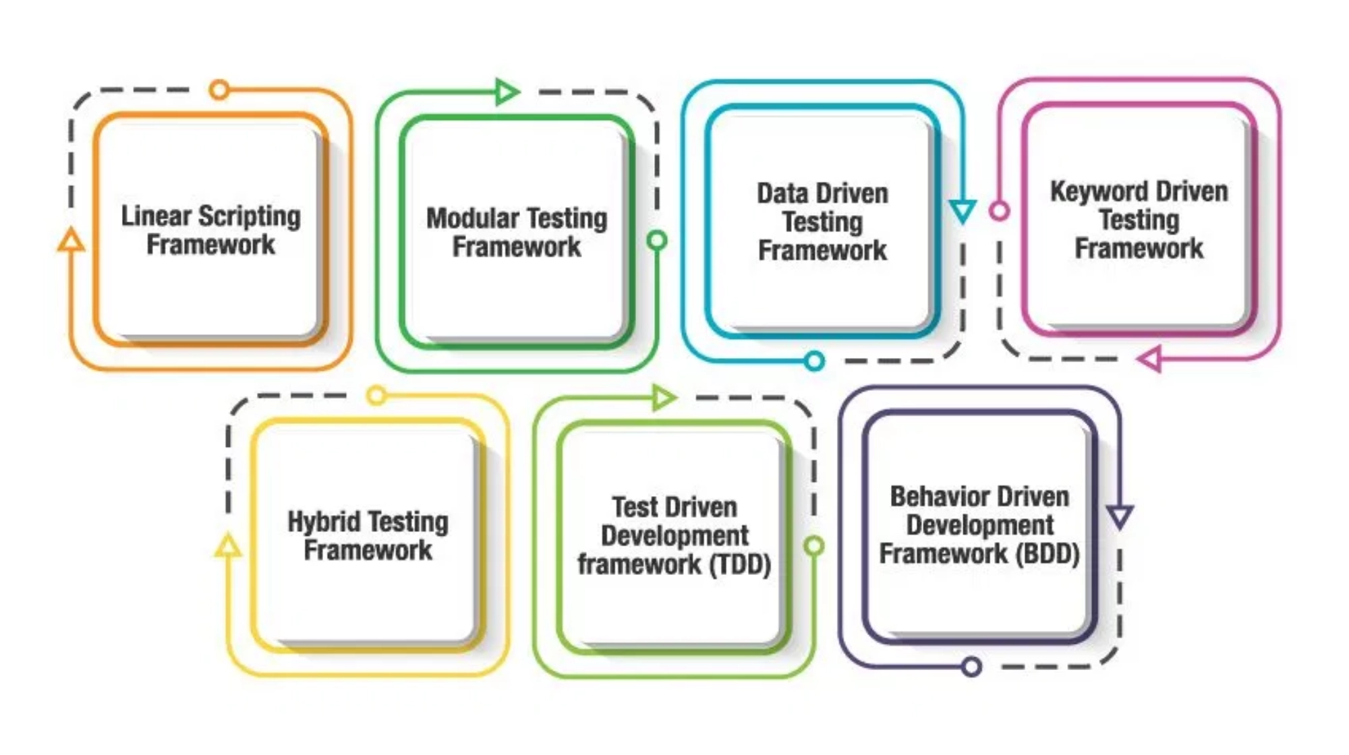



Conclusion & Recommendations
Key Findings
Multi-layered Testing is Essential
Cloud systems require a comprehensive approach covering unit, integration, E2E, API, performance, security, and accessibility testing.
Strategic Patterns Drive Efficiency
Test Pyramid and Testing Trophy provide frameworks for balancing test types, with shift-left testing reducing costs and improving quality.
Environment Strategy is Critical
Ephemeral environments, mocks/stubs, and proper data management ensure consistent, isolated, and efficient testing.
Recommendations
Adopt a Layered Testing Strategy
Implement a balanced approach based on the Test Pyramid or Testing Trophy, tailored to your specific application architecture.
CI/CD Integration is Non-negotiable
Fast feedback loops and quality gates in CI/CD pipelines are essential for maintaining quality in cloud systems.
Invest in Ephemeral Environments
Utilize containerization and infrastructure-as-code to create consistent, isolated test environments that mirror production.
Tool Selection is Ecosystem-Dependent
Testing tools should be selected based on specific ecosystem needs (JavaScript/Angular, C#/.NET) and integration capabilities.
Automate Testing in CI/CD
Integrate comprehensive testing into CI/CD pipelines with appropriate quality gates at each stage.
Measure and Improve Continuously
Track key testing metrics and establish feedback loops for ongoing improvement of testing processes.
Cloud Testing Market Research
10

